Slide 1
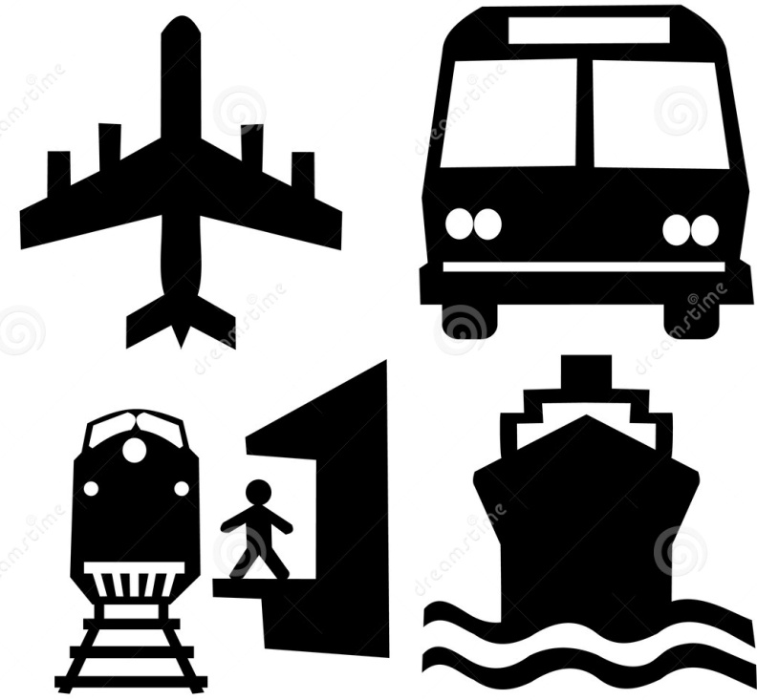
who prefers this means of transport;
what advantages of travelling this way are;
what disadvantages of travelling this way are.

Slide 2
Form collocations
check-in
baggage
departure
departure
duty-free
conveyer
passport
desk
re-claim
board
lounge
shop
belt
control

Slide 3
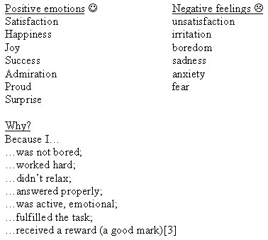


I
f
e
e
l

